Slide 1
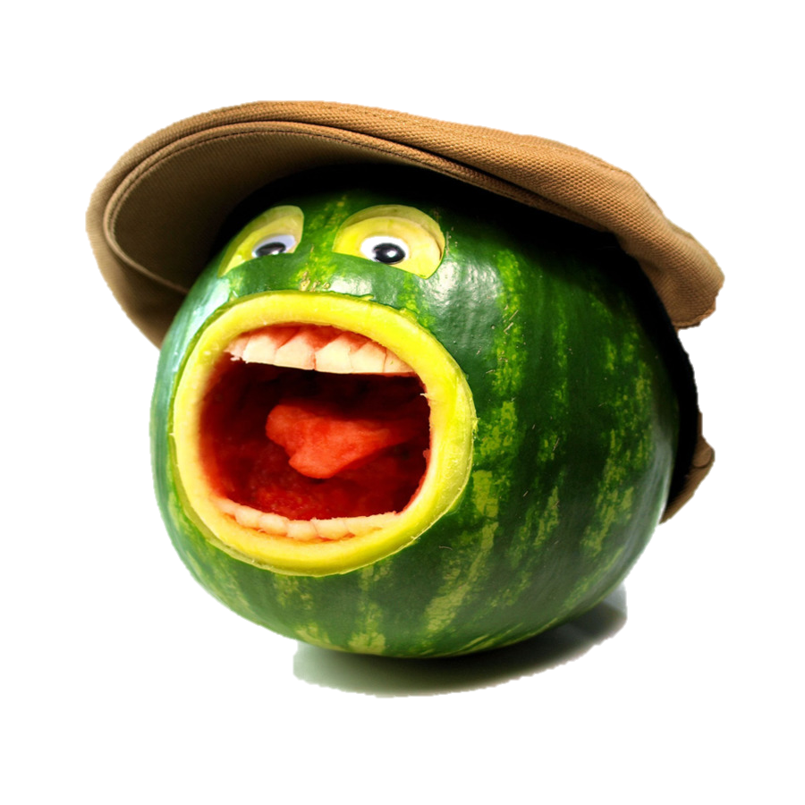
Technology and Diabetes Management
Course Project 6:
Food/Non-Food Image Classifier
Giuliano Cairoli
Marco Wyss
Arina Shvetsova

Slide 2
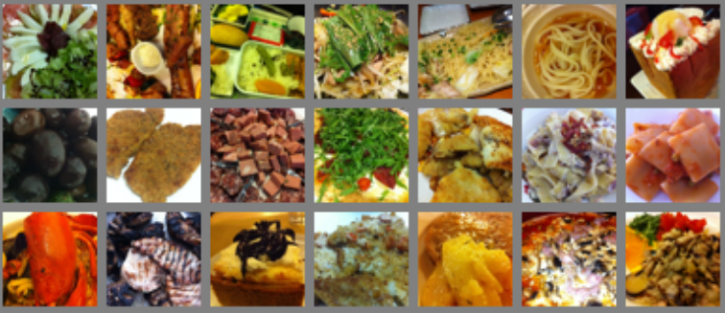
Food/Non-Food Image Classifier
Use of Artificial Intelligence (AI) and machine learning (ML)
Reinforcement learning
Training (80%) and validation (20%) data:
UNICT-FD889 dataset with 3583 food images
Flickr dataset with 4804 food and 8005 non-food images
200 images for evaluation
Images from web for reinforcement learning

Slide 3
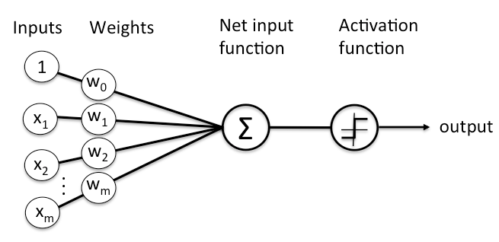
Neural network (ANN)
Input images give some specific outputs
Images can be highly correlated as well highly different
NN is sensitive to the location of a specific object in an image
Neurons’ number related to size and channels of images
Could lead to high computational effort

Slide 4
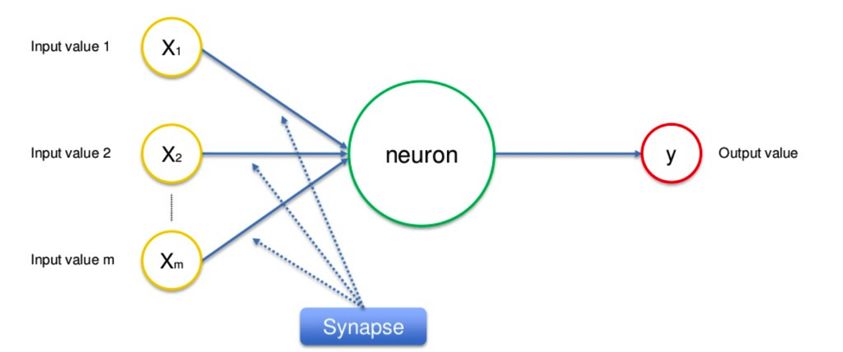
Neurons
A set of neurons fire
Sum of all neurons taken
Decision making

Slide 5
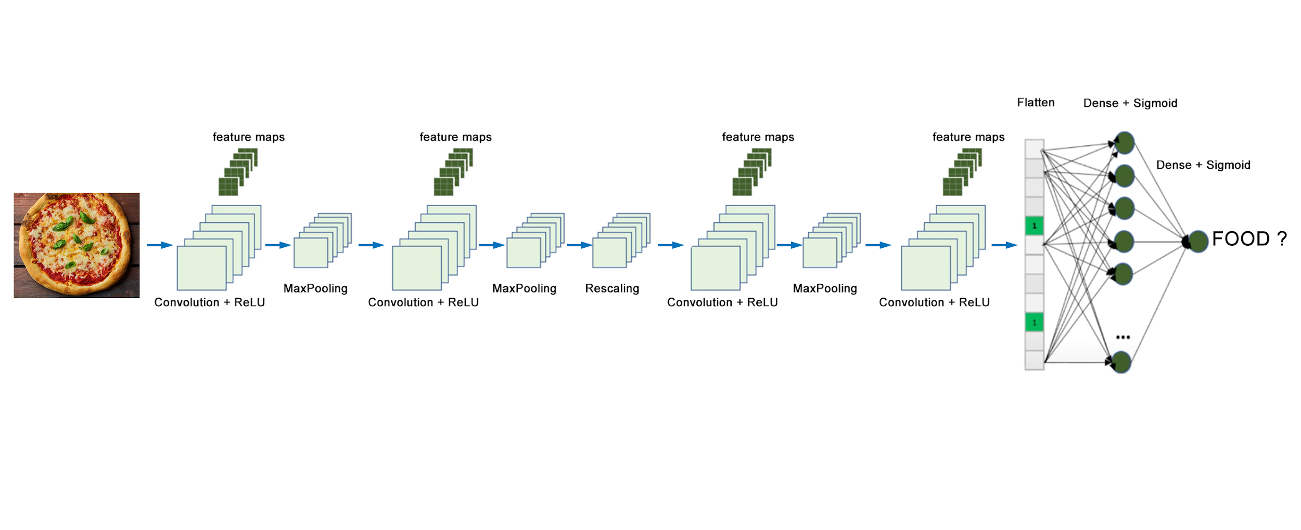
Convolutional neural network
Based on feature maps
CNN is not sensitive to the location of a specific object in an image
Kernels can have many channels - semantic features
Goal: establish a neural network based on features detection
(binary classification)
Notes:
Semantic ( senso logico)
Prima del flatten : feature extraction
Dopo flatten: classsification

Slide 6

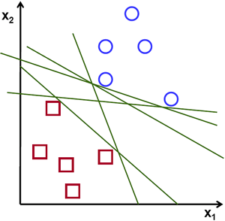
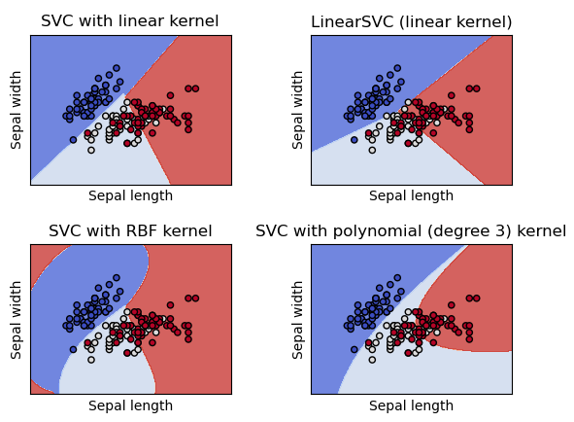
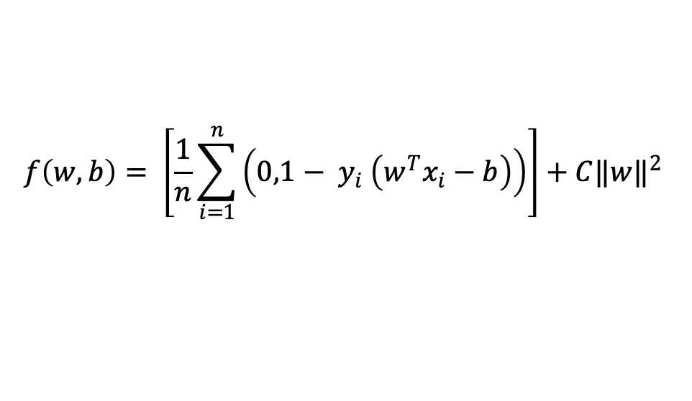
Support Vector Machine
Classification and regression analysis
Pixel-vise classification
Hyperplanes: linear, polinimial, rbf
Optimal hyperplane is chosen based on the maximum marginal hyperplane that best divides the dataset into classes
$$f\left(w,b\right)= \left[\frac{1}{n}\sum_{i=1}^{n}{\left(0,1− y_{i} \left(w^{T}x_{i}−b\right)\right)}\right]+C{‖w‖}^{2}$$
Notes:
Support vector machine is standart regression and classification technique. SVM constructs planes that separate data the best way. The best way in this case is that different categories are placed the furthest way from separation plane. There are different types of hyperplanes that are used: liner, rbf (radial basis function), polynomial. In other words we just need to solve an optimization problem with given parameters: where $w$ is the normal vector to the hyperplane and the parameter $C>0$ determines the trade-off between increasing the margin size and ensuring that the $x_{i}$ lies on the correct side of the margin.

Slide 7
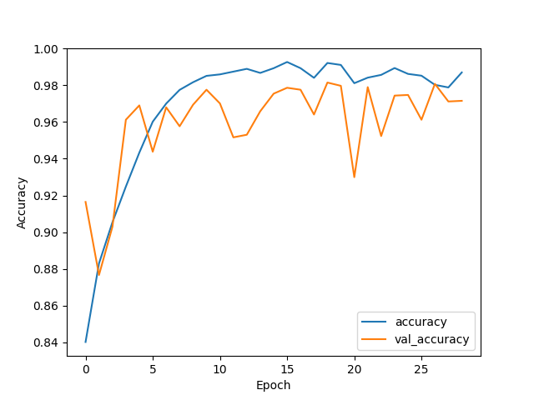
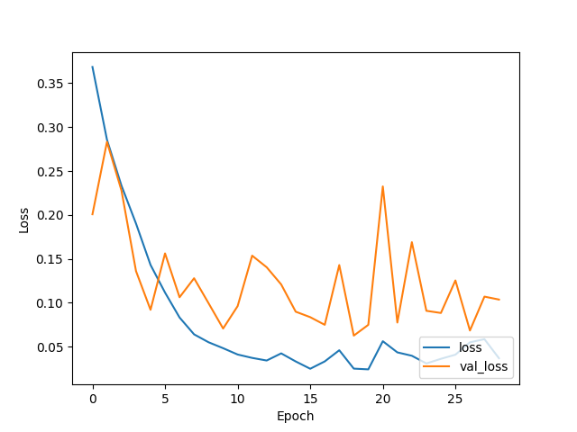
CNN classifier results
Accuracy: 98.7%
Validation accuracy: 97.16%
Loss: 3,69%
Validation loss: 10,37%
The maximum accuracy reached within 29 epochs with 44 seconds per epoch. Overall time complexity is 21 minutes.

Slide 8
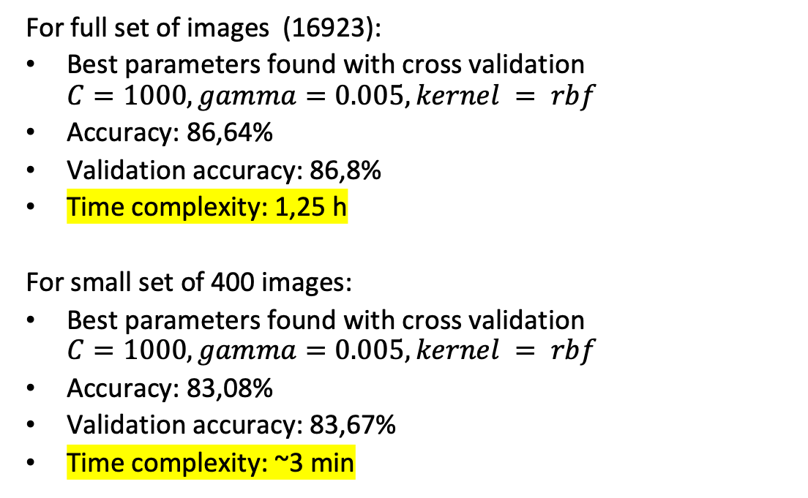
SVM classifier results
For full set of images (16923):
Best parameters found with cross validation $C=1000, gamma=0.005, kernel = rbf$
Accuracy: 86,64%
Validation accuracy: 86,8%
Time complexity: 1,25 h
For small set of 400 images:
Best parameters found with cross validation $C=1000, gamma=0.005, kernel = rbf$
Accuracy: 83,08%
Validation accuracy: 83,67%
Time complexity: ~3 min
Notes:
So why can we have smaller amount of data: basically algorithm decomposes all pictures to the pixels, draw them in space and find an optimal Hyperplane. It saves this hyperplane in file with model. Then with new data set it draws the same hyperplane and according to which side from this plane the most pixels of an image fell it decides for the category of an image. So if we increase amount of data it’s not going to strongly change the plane. That’s why we reach hight accuracy very early. So we need more versatile data then just big amount of data.

Slide 9
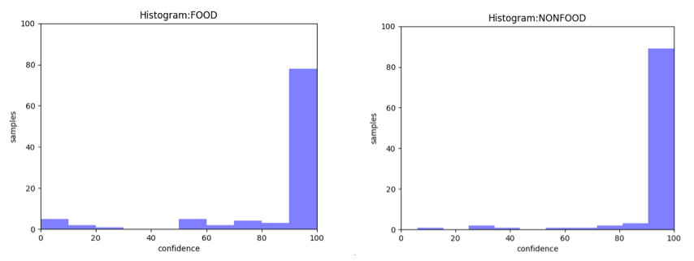
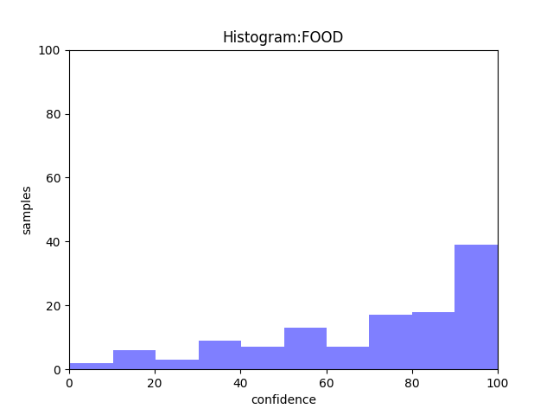
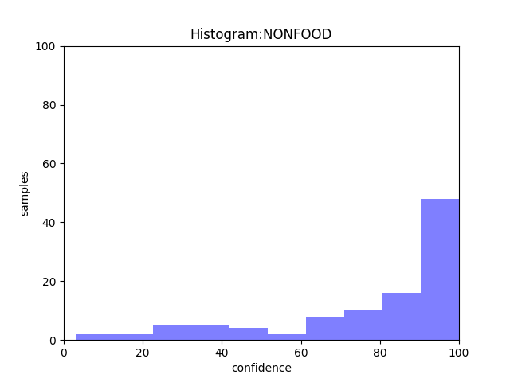
Prediction quantitative results
CNN Classifier
 | CNN Classifier |  | SVM Classifier
 | FOOD | NON- FOOD | FOOD | NON- FOOD
Predicted as FOOD | 87 (TP) | 4 (FP) | 81 (TP) | 19 (FP)
Predicted as NONFOOD | 13 (FN) | 96 (TN) | 40 (FN) | 83 (TN)
Sensitivity | 87% |  | 67%
Specificity | 96% |  | 81%
DICE | 91,1% |  | 73,3%
SVM Classifier

Slide 10
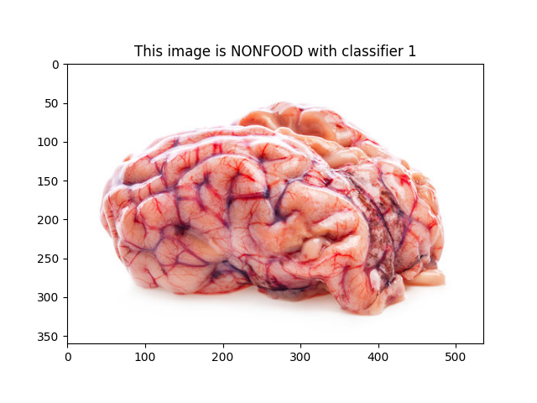

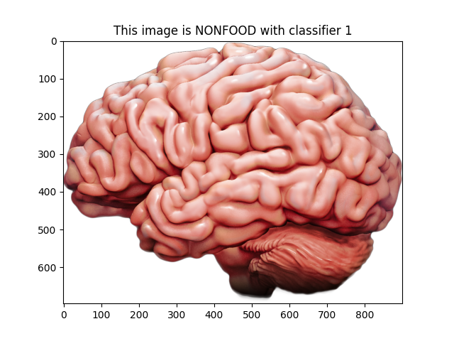

Prediction qualitative results
CNN Classifier
SVM Classifier
With confidence of 69,5%
With confidence 95,5%
CNN clasifier uses features:
Shape
Intensity
Gradient intensity
Texture
Eigen values
SVM classifier doing pixel-vise:
Intensity
Texture
With confidence of 64%
With confidence 95,3%
Notes:
Apart from quantitative results we have qualitative results where we could actually understand better what’s going on in each classificator

Slide 11
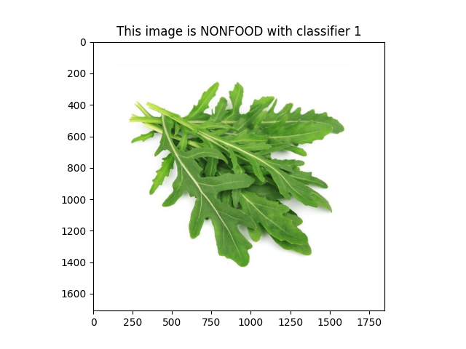
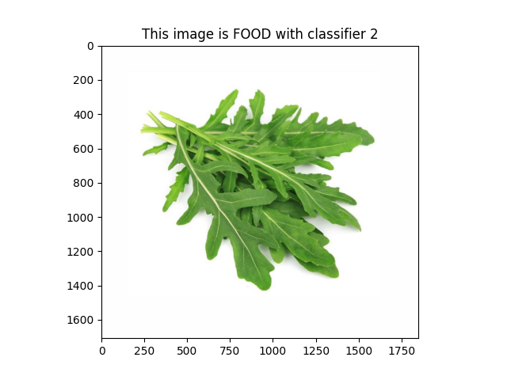
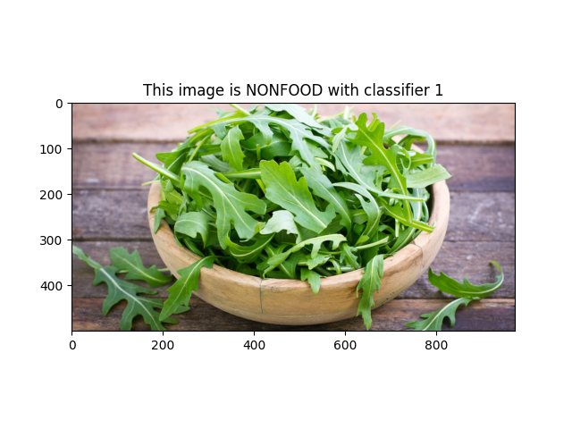

Prediction qualitative results
CNN Classifier
SVM Classifier
CNN clasifier uses features:
Shape
Intensity
Gradient intensity
Texture
Eigen values
SVM classifier doing pixel-vise:
Intensity
Texture
With confidence of 70,2%
With confidence 95,5%
With confidence of 62,1%
With confidence 93,4%
Notes:
CNN depends a lot on training data set. SVM classifier depends less on it (very robust). Mention asian food

Slide 12
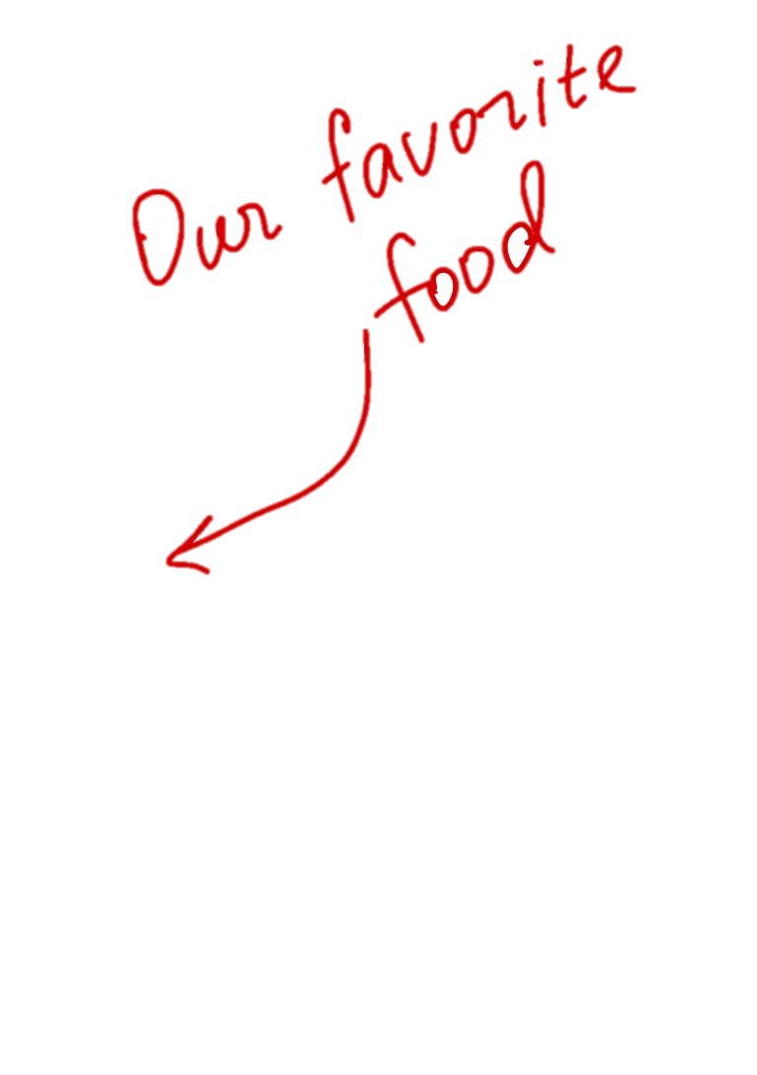
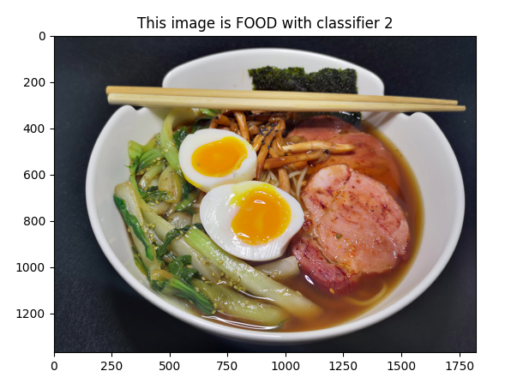
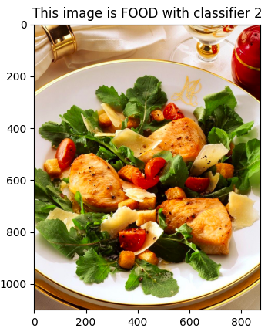
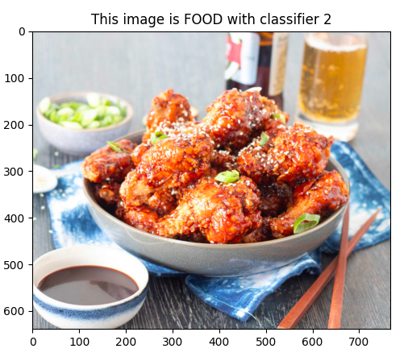
Conclusion
Both, the CNN and the SVM classifier are suitable methods for Food/Non-Food classification
CNN classifier has overall better results in prediction
For very specific cases both classifier can give unexpected results
Acceptable result in the context of this project, but insufficient for a nutritional or medication tool

Slide 13


Pros and cons
CNN Classifier
+ Connection sparsity -> less overfitting
+ Convolution + pooling gives location invariant feature detection
+ ReLU introduces nonlinearity and fast to compute
+ Pooling methods can help to reduce dimension -> less computation effort
+ Pooling reduces overfitting (less parameters)
- CNN do not encode the position and orientation of object
- Large data set necessary
SVM Classifier
+ No need of large data sets
+ Robust
+ Outliers have small influence
+ Performs a very good generalization
+ Supports high dimensionality
- Has high computational and time complexity - O(n³)
Has significantly lower performance on noisy data
In cases where the number of features for each data point exceeds the number of training data samples, the SVM will underperform.

Slide 14
Improvements
In general:
Combining approaches: CNN for the feature-extraction and a SVM for the classification
CNN:
Optimize parameters like: number of layers, size of layers, complexity of the NN, activation function, number of training epochs
Data augmentation to improve training
Geometric and photometric variants: Flip, rotation, zoom, etc.
Dropout
Other Neural Networks like: ResNet, AlexNet, U-net
SVM:
Pre-processing
Feature extraction

Slide 15
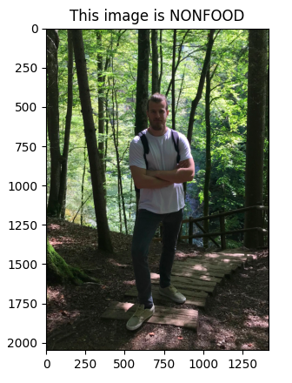
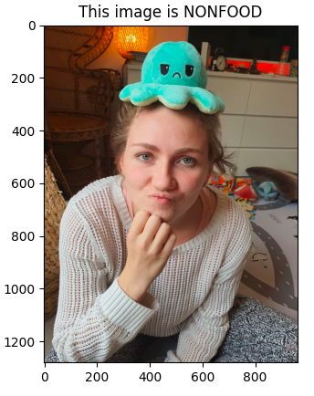
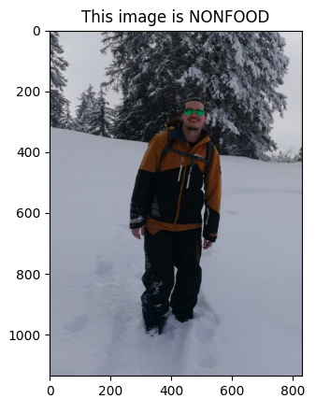
Thank you for attention

